Slide 1


Welcome to our class
Teacher: PhamXuanKhanh

Slide 2
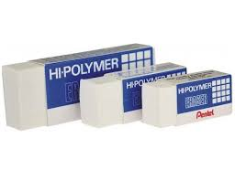
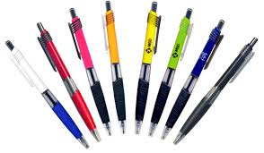
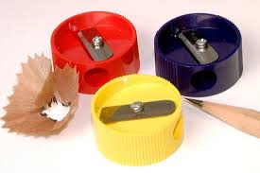

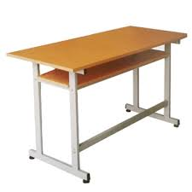
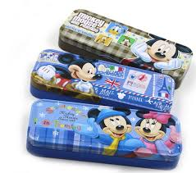
Matching game
d
a
Pens
Pencil cases
Rubbers
Desk
Book
Pencil sharpeners
b
e
c
f

Slide 3

Wednesday, November 18th ,2015
Unit 8 : This is my pen.
Lesson 3: 1,2,3

Slide 4
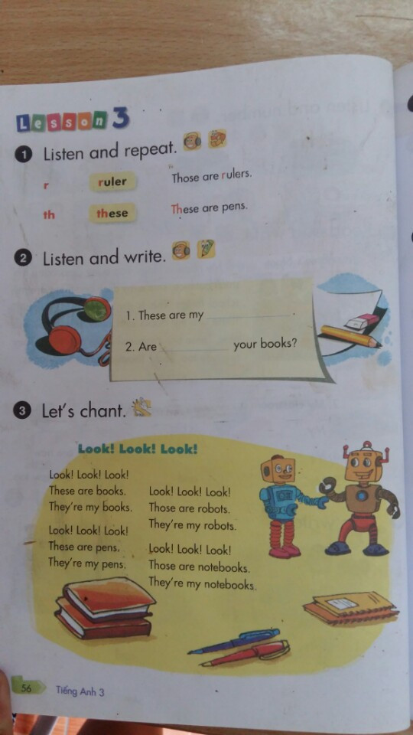
R : ruler, rubber, room, read, repeat……
th : these, those, they,that, this, thanks, thursday………

Slide 5
rulers
these

Slide 7

Good bye see you again !

